Slide 1

Tool : NIDS
SNORT3
Prepared By-
1905048 - Md. Al-Amin Sany
1905052 - Bijoy Ahmed Saiem

Slide 2

Introduction to Snort
Ø A versatile IDS/IPS that offers real-time analysis of network
traffic to detect and respond to potentially malicious activities
Ø It operates on a rule-based system, where users can define
custom rules or employ pre-existing rule sets to identify and
mitigate threats
Ø Snort’s rule-based approach allows it to monitor network traffic
at both the network and application layers, thereby offering
comprehensive protection against a wide range of network-
based attacks and vulnerabilities.

Slide 3
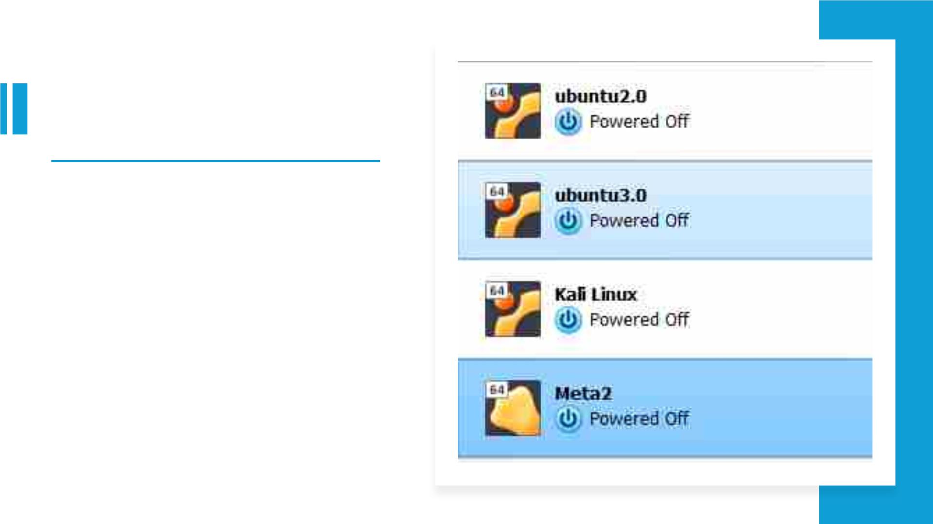
Virtual Machine
Setup
• Snort is used to detect and prevent
various attacks based on predefined
rules. The operations of snort are:
• Packet Sniffing
• Network Intrusion Detection and
Prevention
• Packet Logging

Slide 4
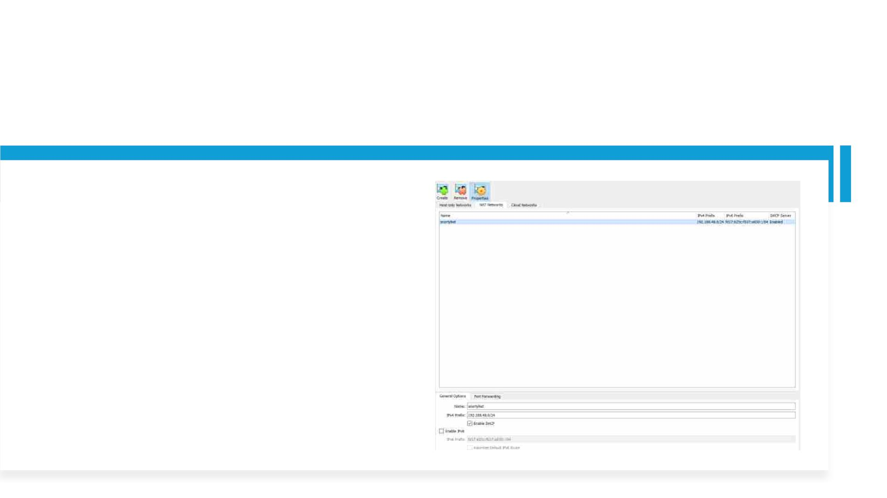
Snort3 rules operate similarly to conventional firewall rules. They are designed to analyze network activity, looking fo
specific patterns or signatures. When a match is found, Snort3 can take action by either generating an alert or droppi
packet if configured as an Intrusion Prevention System (IPS). This proactive approach helps in enhancing network se
by identifying and responding to potential threats in real-time. For verifying this a home network is created below.
• A Home Network(Name : snortyNet ,
IP : 192.168.48.0/24) is Created

Slide 5
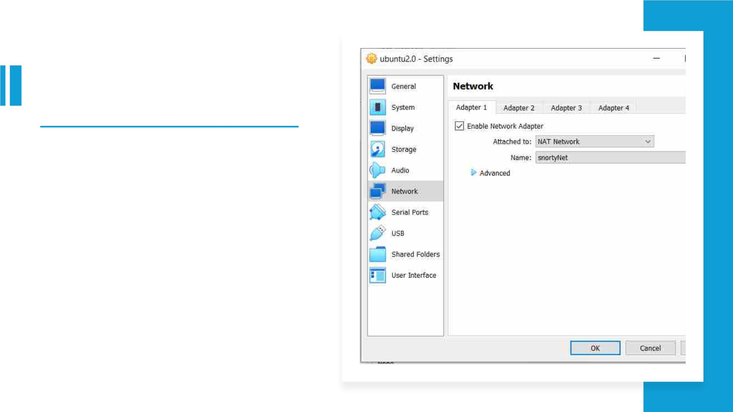
• Virtual Machines are connected to
the Home Network

Slide 6
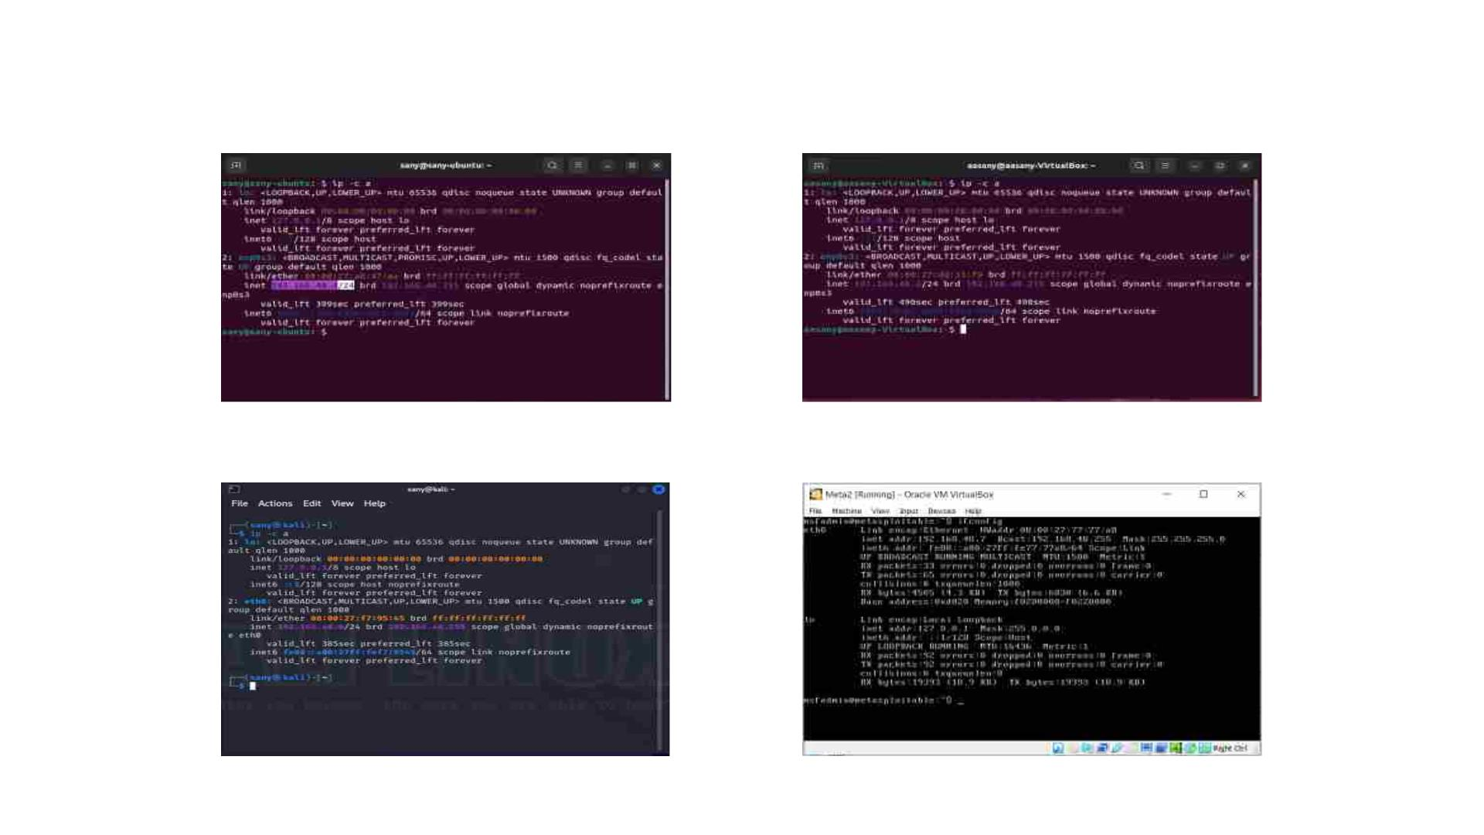
The IP addresses of all Virtual Machines must be within the same subnet to connect with each other.
IP addresses of the four VMs
Ubuntu2.0
IP:192.168.48.4
Ubuntu 3.0
IP:192.168.48.5
Kali Linux
IP:192.168.48.6
Metasploitable2
IP:192.168.48.7

Slide 7
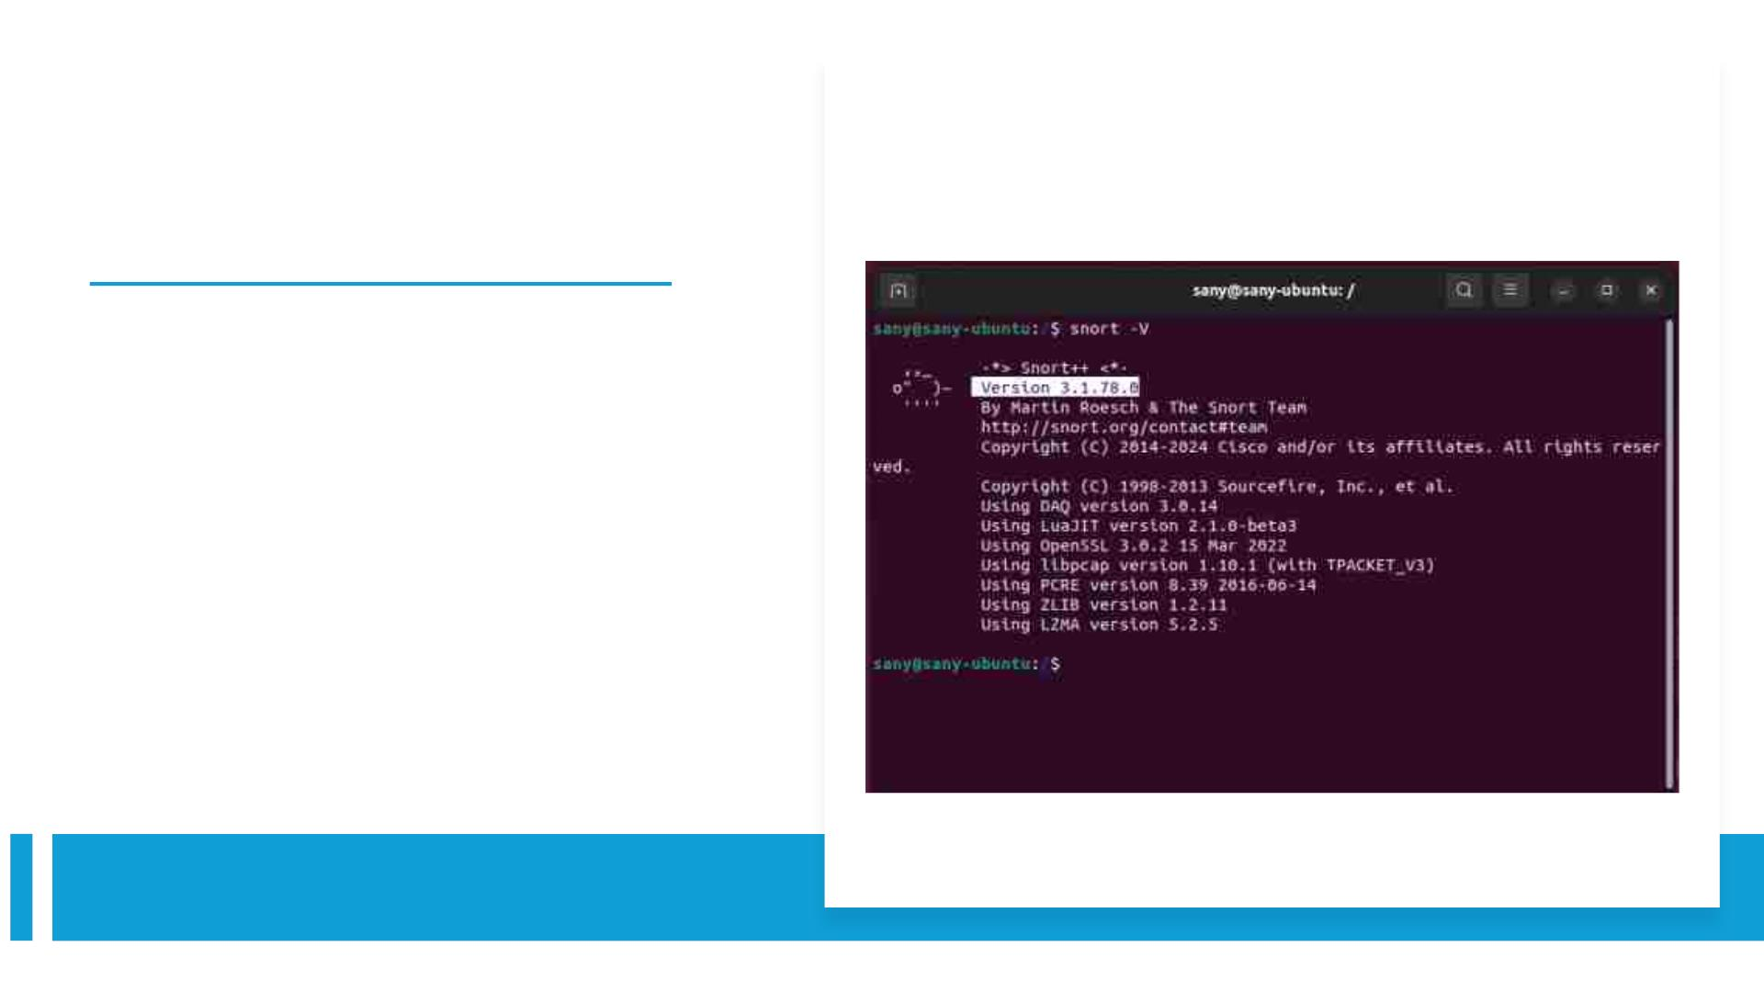
Snort Version : 3.1.78.0
• Threading and shared memory allow
us to scale Snort 3 to our network and
create a much faster start-up.
• This allows multiple packet
processing to free up more memory for
more packet processing power.

Slide 8
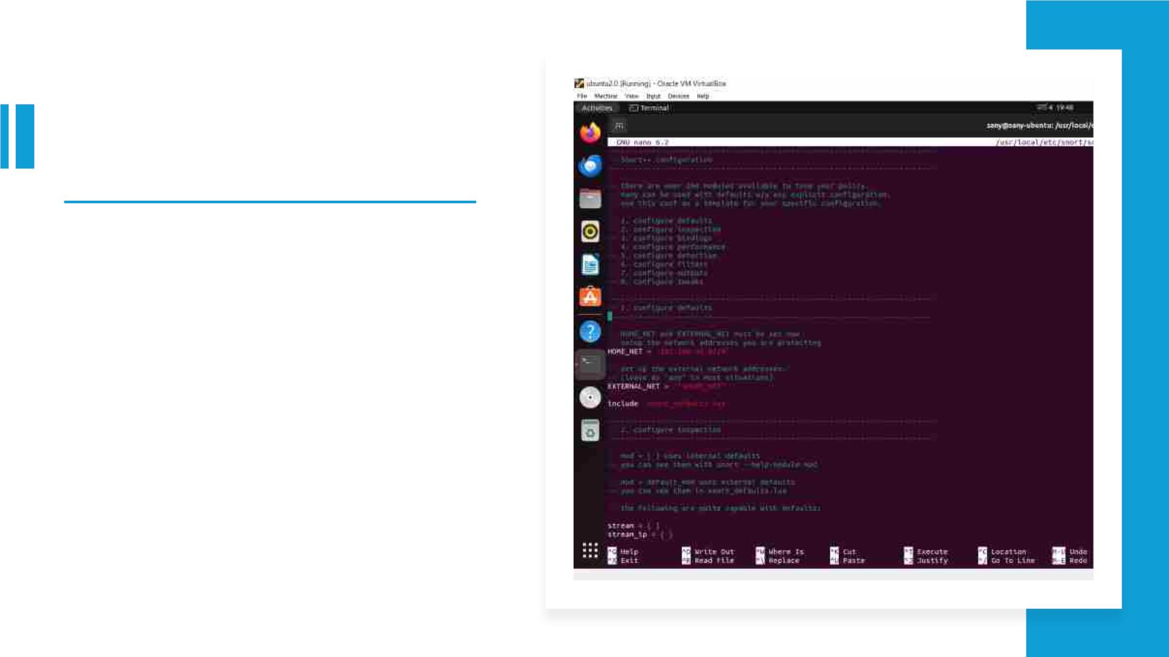
• Snort 3 Configaration
• Home NET:192.168.48.0/24

Slide 9
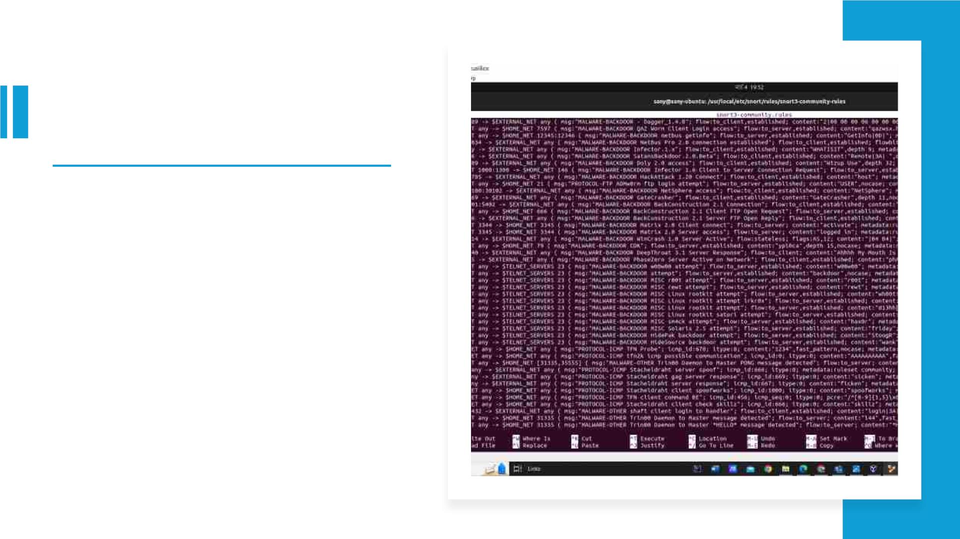
• Snort3 Community Rules

Slide 10
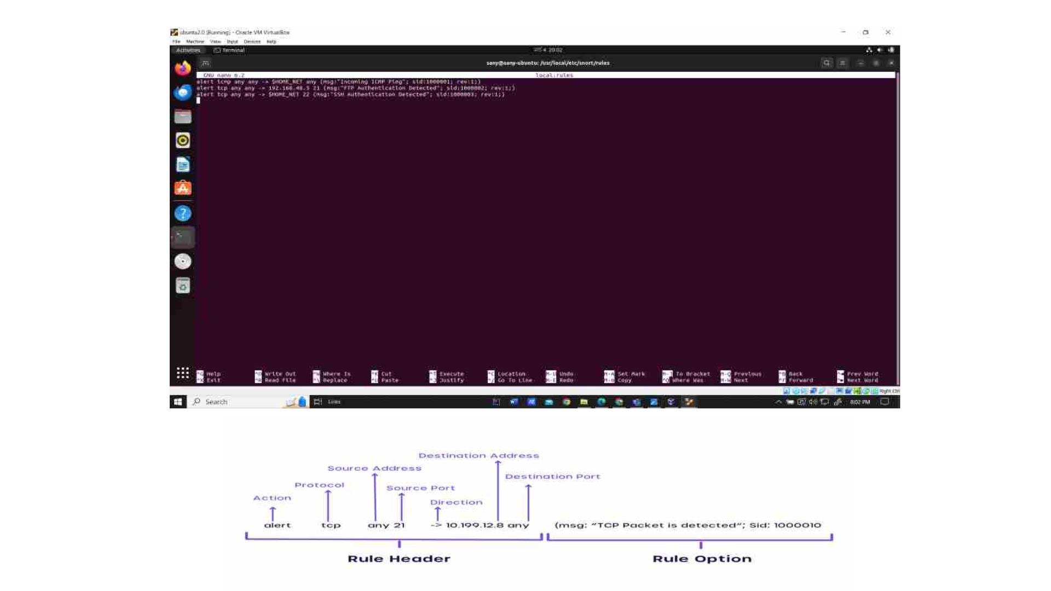
Snort3 Custom
Rules

Slide 11
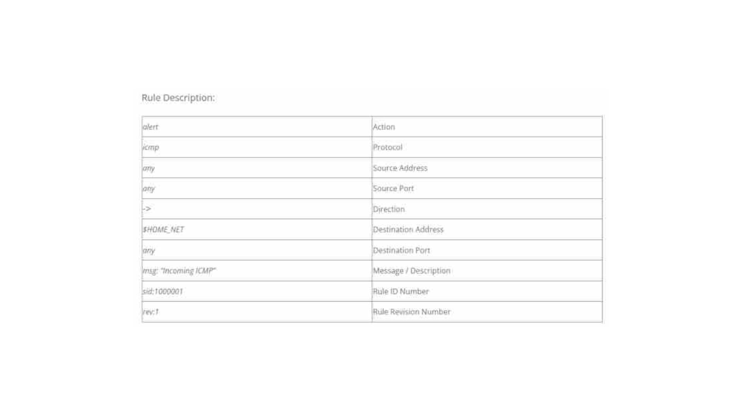
Snort3 Rules Description

Slide 12
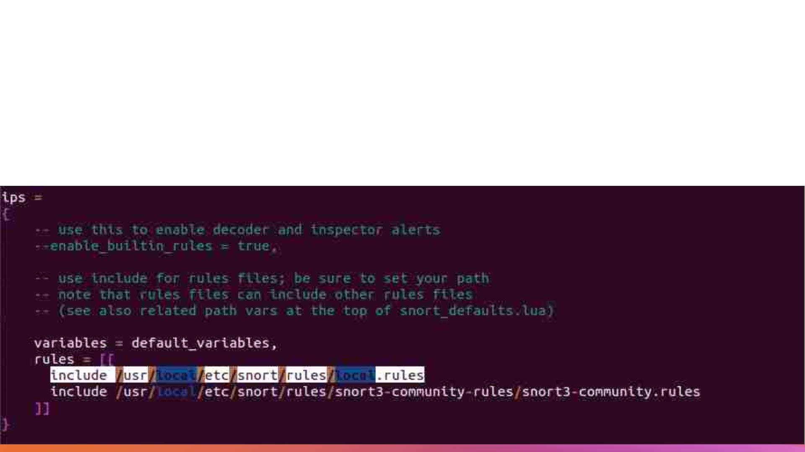
• Local Rules Set up in Configuration
File(snort.lua)

Slide 13
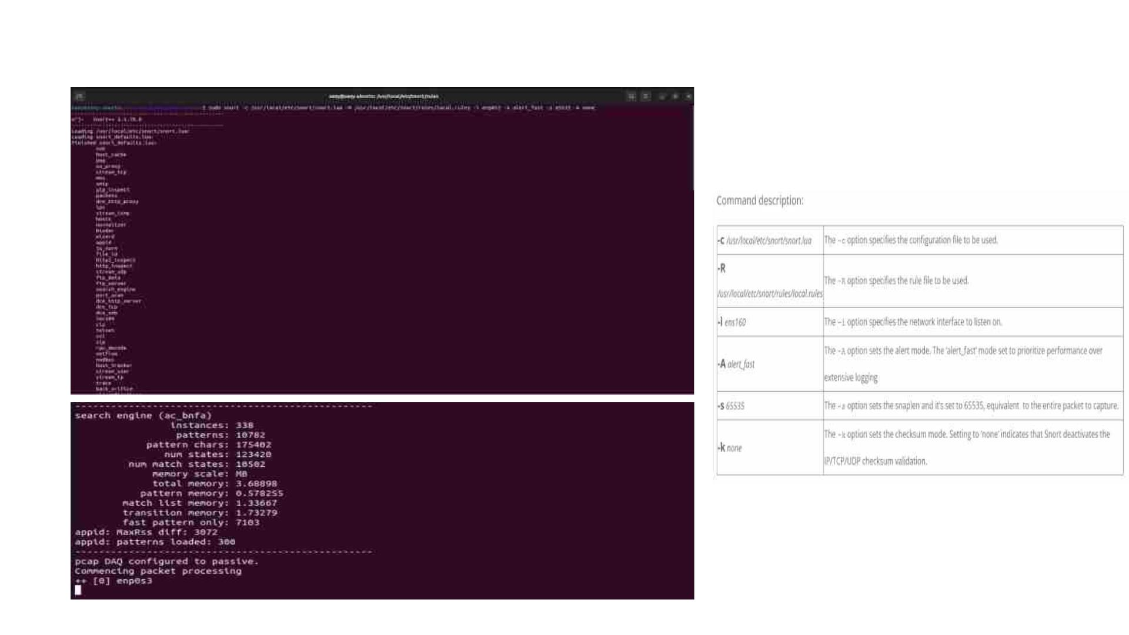
Snort3 Manual Trigger

Slide 14
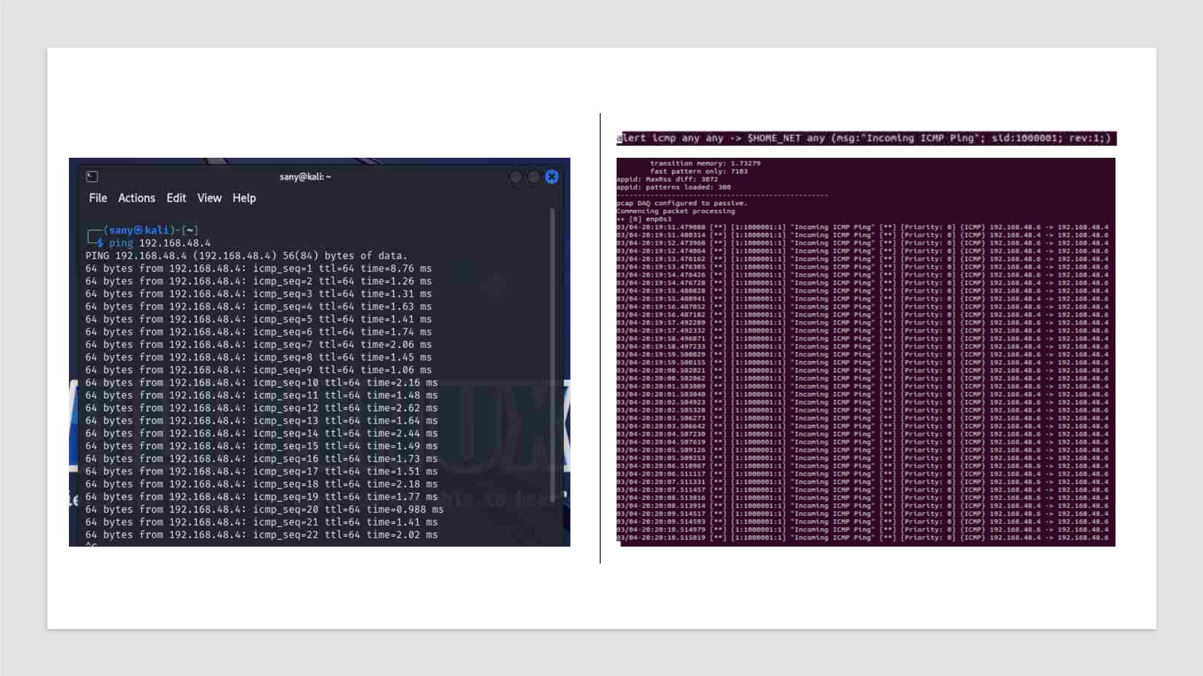
A ping command is executed from Kali Linux to test the connectivity to our Ubuntu 2.0

Slide 15
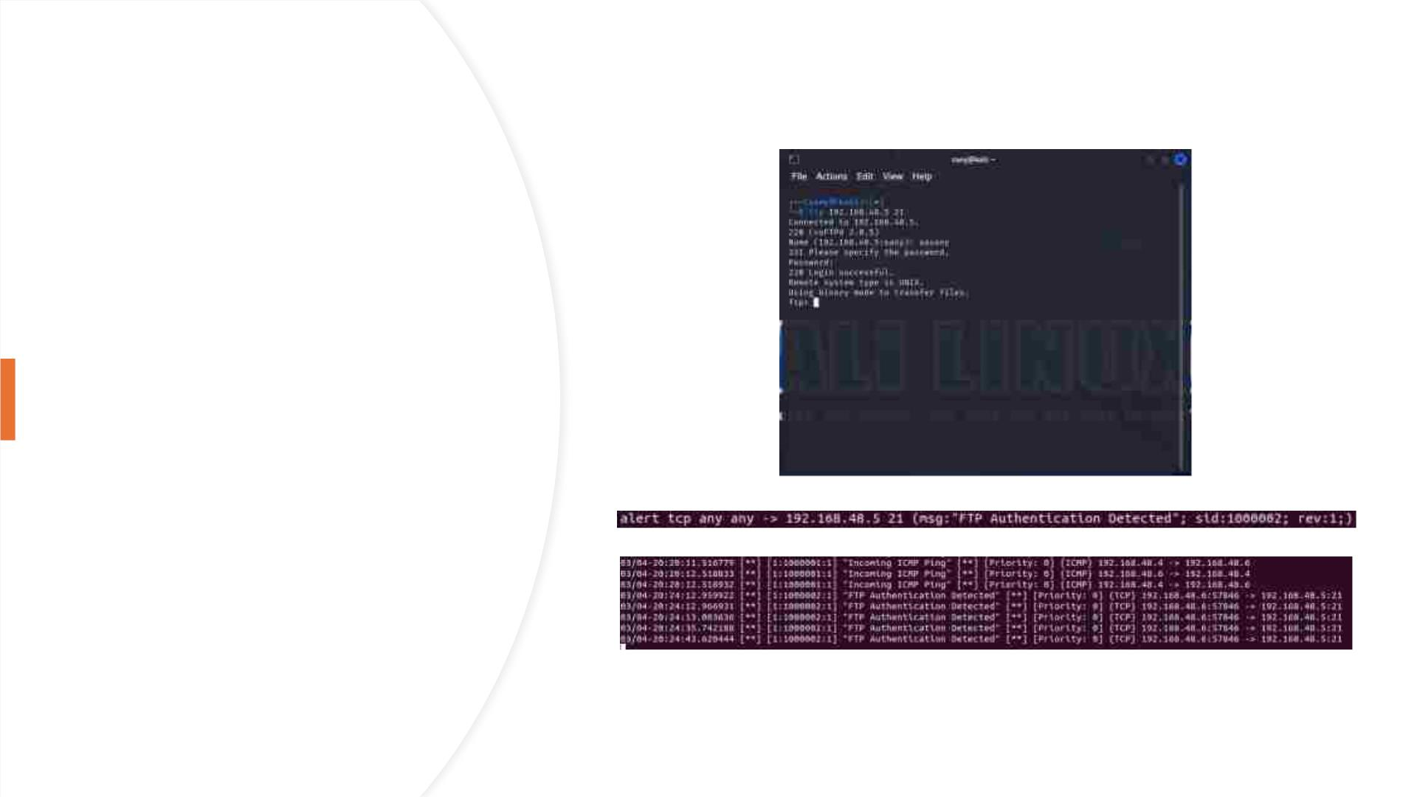
To initiate an
FTP (File
Transfer
Protocol)
connection to
Ubuntu 3.0 on
port 21 from
Kali Linux.

Slide 16
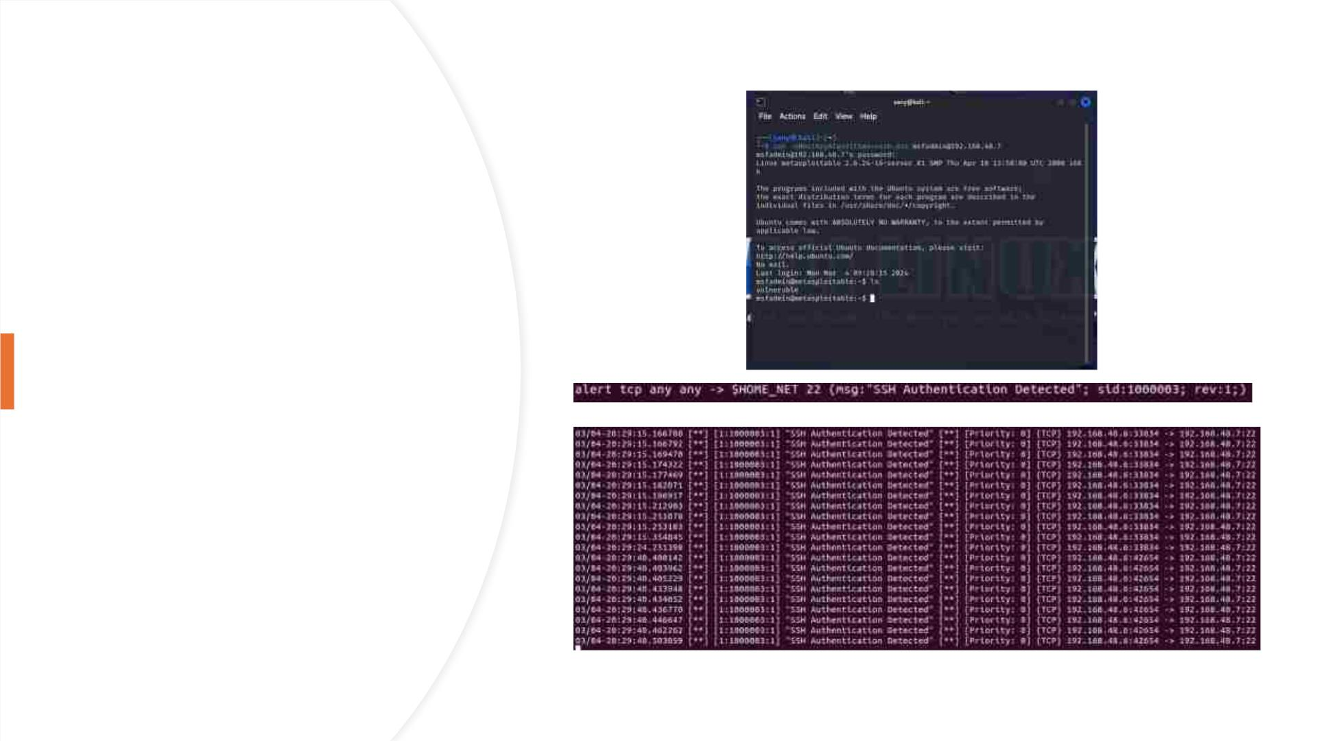
To establish an
SSH
connection to
Metasploit2
with specific
configuration
options from
Kali Linux.

Slide 17
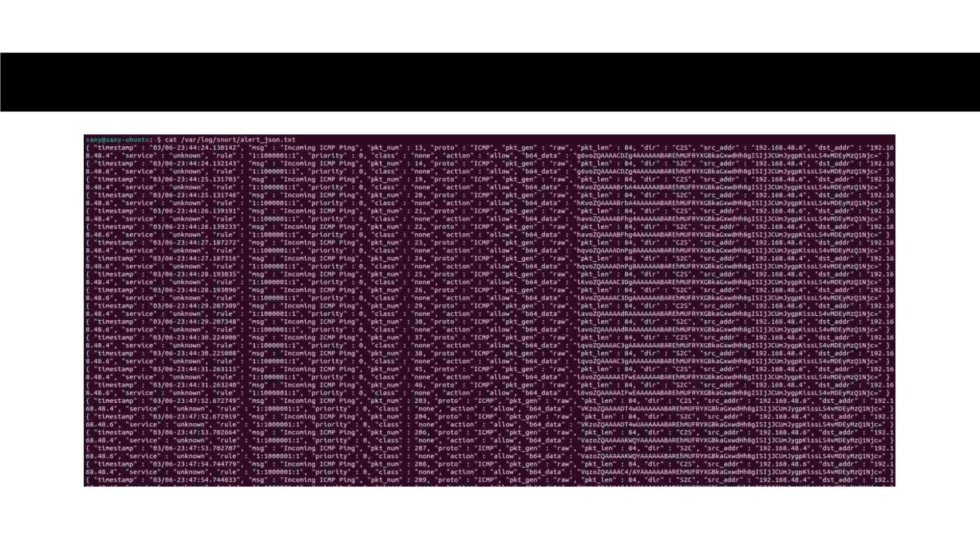
Logging In Json Structure

Slide 18
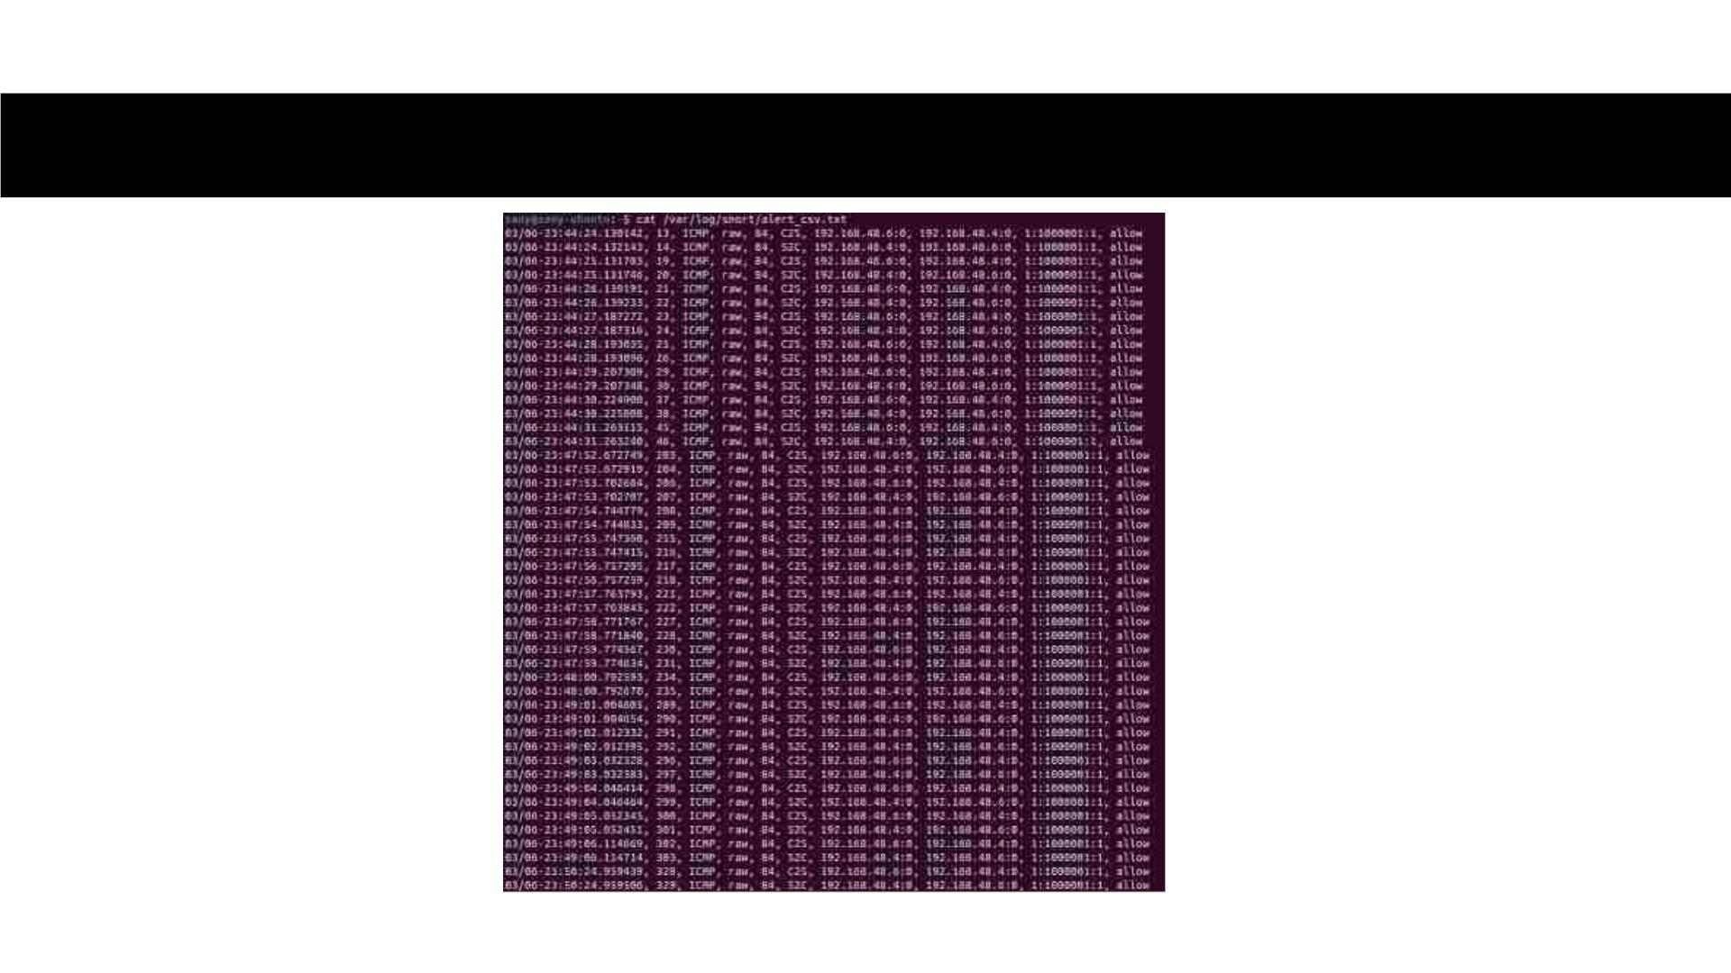
Logging in CSV Structure

